Slide 1



A Summary of 1076 - 2019 IEEE Standard VHDL Language Reference Manual
by Furkan Kaya, Koray Karakurt,
Mert Ecevit, Orhan Çalışkan, Seyit Koçak and Yunus Küçük
27/12/2024

Slide 2
3. Design entities & configurations
Chapter 3
Presenter:
Furkan Kaya
3.1 General
3.2 Entity Declarations
3.3 Architecture Bodies
3.4 Configuration Declarations

Slide 3
3.1 GENERAL
Examples 1 and 3 taken from "IEEE1076-2019" document where example 2 is my example.
Design Entity:
Entity declaration
Architecture bodies
Configuraiton decleration
3.2 ENTITY DECLARATIONS | 3.3 ARCHITECTURE BODIES | 3.4 CONFIGURATION DECLARATIONS
An entity in VHDL defines the external interface of a design.
An architecture in VHDL describes the internal implementation of an entity.
A configuration in VHDL specifies how components within an architecture are bound to entities and architectures.
entity Full_Adder is
port ( X, Y, Cin: in Bit;
Cout, Sum: out Bit
);
end Full_Adder;
entity AndGate is
generic (
N: Natural := 2
)
port(
inputs : in bit_vector (1 to N);
result : out bit
);
end entity AndGate;
entity TestBench is
end TestBench;
architecture Behavioral of SENSOR_CNTRLLR is
component I2C_master is
...
end component I2C_master;
constant POR_LIM : integer := 99_999;
type SENSOR_STATES is (
POR_WAIT,CONFIG_SENSOR, TAKE_DATA,BFT_WAIT
);
signal sensor_ctrl_state : SENSOR_STATES;
signal por_cnt : integer range 0 to POR_LIM;
begin ...
library TTL, Work;
configuration V4_27_87 of Processor is
use Work.all;
for Structure_View
for A1: ALU
use configuration TTL.SN74LS181;
end for;
for M1,M2,M3: MUX
use entity Multiplex4 (Behavior);
end for;
for all: Latch
-- use defaults
end for;
end for;
end configuration V4_27_87;
EX-1
EX-2
EX-3

Slide 4
CODE EXAMPLE
library IEEE;
use IEEE.std_logic_1164.all;
use IEEE.numeric_std.all;
entity generic_adder is
generic
(
data_width : integer := 32
);
port
(
input_a : in std_logic_vector (data_width-1 downto 0);
input_b : in std_logic_vector (data_width-1 downto 0);
output_adder : out std_logic_vector (data_width downto 0)
);
end generic_adder;
architecture behavioral of generic_adder is
signal output_internal : signed (output_adder'range);
begin
output_internal <= signed(input_a) + signed(input_b);
output_adder <= std_logic_vector(output_internal);
end architecture behavioral;

Slide 5
4. Subprograms & packages
Chapter 4
Presenter:
Seyit Koçak
4.1 General
4.2 Subprogram Declarations
4.3 Subprogram Bodies
4.4 Subprogram Instantiation Declarations
4.5 Subprogram Overloading
4.6 Resolution Functions
4.7 Package Declarations
4.8 Package Bodies
4.9 Package Instantiation Declarations
4.10 Conformance Rules

Slide 6
4.1 GENERAL
Subprograms define algorithms through procedures and functions, serving to compute values or perform actions
Procedures are subprograms that execute a series of statements to perform actions but do not return a value. They are called as statements and can modify the state of the program
Functions are classified as pure or impure
Packages separate the declarations and bodies of these subprograms, allowing common resources to be shared
4.2 SUBPROGRAM DECLERATİONS
Subprogram declarations define procedures or functions by specifying their designator, parameters, generics (if any), and for functions, the return type and whether it is pure or impure
Procedures are always identified by a name, while functions can also be identified by operator symbols, enabling operator overloading
Functions return a value, whereas procedures execute actions without returning any value and can modify external variables or signals
-

Slide 7
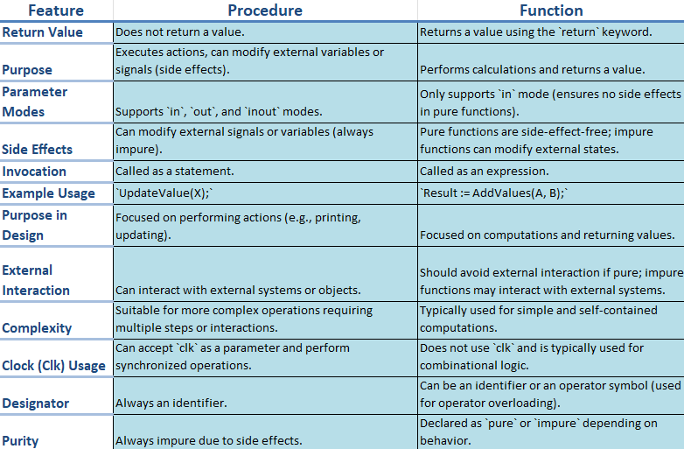
CODE EXAMPLE
library IEEE;
use IEEE.std_logic_1164.all;
use IEEE.numeric_std.all;
entity procedurewithclock is
port (
clk : in std_logic;
reset : in std_logic;
data_in : in std_logic_vector(7 downto 0);
data_out : out std_logic_vector(7 downto 0)
);
end procedurewithclock;
architecture behavioral of procedurewithclock is
procedure updatevalue(
signal clk : in std_logic;
signal reset : in std_logic;
signal data_in : in std_logic_vector(7 downto 0);
variable data_out : inout std_logic_vector(7 downto 0)
) is
begin
if reset = '1' then
data_out := (others => '0');
elsif rising_edge(clk) then
data_out := data_in;
end if;
end procedure;
begin
process(clk, reset)
variable temp_data : std_logic_vector(7 downto 0);
begin
updatevalue(clk, reset, data_in, temp_data);
data_out <= temp_data;
end process;
end behavioral;

Slide 8
4.2 SUBPROGRAM DECLARATİONS
Pure functions always return the same output for the same input values
Impure functions may produce different outputs for the same inputs or modify external variables or signals
Constant parameters allow read-only access, while variable parameters allow both reading and writing of values during subprogram execution.
Signal parameters pass references to signals, their drivers, or both into the subprogram call Assignments to signal parameters directly affect the actual signal drivers associated with them
4.3 SUBPROGRAM BODIES
A body consists of three main parts: specification (definition of parameters and type), declarative part (variables, constants, or nested subprograms), and statement part (sequential operations)
4.4 SUBPROGRAM INSTANTIATION DECLARATIONS
Subprogram instantiation customizes a general subprogram template into an independent version with specific parameters or generics

Slide 9
CODE EXAMPLE
library IEEE;
use IEEE.std_logic_1164.all;
use IEEE.numeric_std.all;
package my_subprograms is
function add_integer(a, b: integer) return integer;
end my_subprograms;
package body my_subprograms is
function add_integer(a, b: integer) return integer is
begin
return a + b;
end add_integer;
end my_subprograms;
use work.my_subprograms.all;
entity subprograminstantiationexample is
port (
a, b : in integer;
c, d : in integer;
result_int : out integer;
result_real: out integer
);
end subprograminstantiationexample;
architecture behavioral of subprograminstantiationexample is
constant threshold : integer := 10;
begin
process(a, b, c, d)
variable tempresultint : integer; --temporary storage
variable tempresultreal : integer;
begin
if (a > threshold and b > threshold) then
tempresultint := add_integer(a, b);
result_int <= tempresultint;
else
result_int <= 0;
end if;
if (c > threshold and d > threshold) then
tempresultreal := add_integer(c, d);
result_real <= tempresultreal;
else
result_real <= 0;
end if;
end process;
end behavioral;

Slide 10
4.7,8,9 PACKAGE DECLARATIONS,BODIES,INSTANTIATION
Package declarations define the interface of a package, including constants, types, subprograms, and generics
Items declared in a package can be made visible in other design units through selection or use clauses
A package body must match its corresponding package declaration and follow it in the same declarative region
Package instantiation declarations create an instance of an uninstantiated package, associating actuals with generics through a generic map aspect
The instance behaves like a generic-mapped package with declarations and bodies from the uninstantiated package
CODE EXAMPLE
library IEEE;
use IEEE.std_logic_1164.all;
package mypackage is
constant default_value: integer := 10;
function double(value: integer) return integer;
function triple(value: integer) return integer;
end package mypackage;
package body mypackage is
function double(value: integer) return integer is
begin
return value * 2;
end function double;
function triple(value: integer) return integer is
begin
return value * 3;
end function triple;
end package body mypackage;
entity packageexample is
port (
inputvalue : in integer;
outputvalue : out integer;
triplevalue : out integer
);
end packageexample;
architecture behavioral of packageexample is
use work.mypackage.all;
begin
process(inputvalue)
begin
outputvalue <= double(inputvalue);
triplevalue <= triple(inputvalue);
end process;
end behavioral;

Slide 11
5. tYPES
Chapter 5
Presenter:
Seyit Koçak
5.1 General
5.2 Scalar Types
5.3 Composite Types
5.4 Access Types
5.5 File Types
5.6 Protected Types
5.7 String Representations
5.8 Unspecified Types

Slide 12
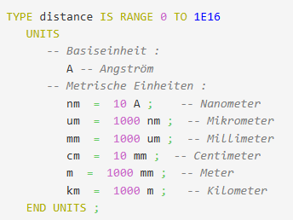
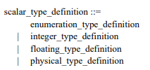
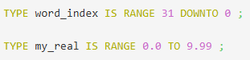
5.1 GENERAL
A type is defined by a set of values and operations, including basic and predefined operations automatically provided
Composite types can be unconstrained, fully constrained, or partially constrained
Types are divided into five main categories: scalar, composite, access, file, and protected types
5.2 SCALAR TYPES

Slide 13
CODE EXAMPLE
library ieee;
use ieee.std_logic_1164.all;
use ieee.numeric_std.all;
entity bcdtoseven is
port (
sw : in std_logic_vector(13 downto 0);
clk : in std_logic;
seg : out std_logic_vector(6 downto 0);
an : out std_logic_vector(3 downto 0)
);
end bcdtoseven;
architecture behavioral of bcdtoseven is
type digit_type is (ones_digit, tens_digit, hundreds_digit, thousands_digit);
signal current_digit : digit_type := ones_digit;
signal ones, tens, hundreds, thousands : std_logic_vector(3 downto 0);
signal slow_clk : std_logic := '0';
signal clk_divider : integer := 0;
function binary_to_seven_segment(input : std_logic_vector(3 downto 0)) return std_logic_vector is
variable seg_output : std_logic_vector(6 downto 0);
begin
case input is
when "0000" => seg_output := "1000000";
when "0001" => seg_output := "1111001";
when "0010" => seg_output := "0100100";
when "0011" => seg_output := "0110000";
when "0100" => seg_output := "0011001";
when "0101" => seg_output := "0010010";
when "0110" => seg_output := "0000010";
when "0111" => seg_output := "1111000";
when "1000" => seg_output := "0000000";
when "1001" => seg_output := "0010000";
when others => seg_output := "1111111";
end case;
return seg_output;
end function;
begin
process(clk)
begin
if rising_edge(clk) then
if clk_divider = 50000 then
slow_clk <= not slow_clk;
clk_divider <= 0;
else
clk_divider <= clk_divider + 1;
end if;
end if;
end process;
process(sw)
variable value_int : integer;
begin
value_int := to_integer(unsigned(sw));
thousands <= std_logic_vector(to_unsigned(value_int / 1000, 4));
hundreds <= std_logic_vector(to_unsigned((value_int / 100) mod 10, 4));
tens <= std_logic_vector(to_unsigned((value_int / 10) mod 10, 4));
ones <= std_logic_vector(to_unsigned(value_int mod 10, 4));
end process;
process(current_digit, ones, tens, hundreds, thousands)
begin
case current_digit is
when ones_digit => an <= "1110"; seg <= binary_to_seven_segment(ones);
when tens_digit => an <= "1101"; seg <= binary_to_seven_segment(tens);
when hundreds_digit => an <= "1011"; seg <= binary_to_seven_segment(hundreds);
when thousands_digit => an <= "0111"; seg <= binary_to_seven_segment(thousands);
when others => an <= "1111"; seg <= (others => '1');
end case;
end process;
process(slow_clk)
begin
if rising_edge(slow_clk) then
case current_digit is
when ones_digit => current_digit <= tens_digit;
when tens_digit => current_digit <= hundreds_digit;
when hundreds_digit => current_digit <= thousands_digit;
when thousands_digit => current_digit <= ones_digit;
when others => current_digit <= ones_digit;
end case;
end if;
end process;
end behavioral;

Slide 14
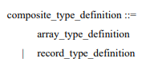
5.3 COMPOSITE TYPES
VHDL arrays store multiple elements of the same type in an organized way and provide fast access
Arrays are used for grouping data, modeling multidimensional structures, and performing operations on large data sets
They serve as a foundation for creating dynamic data structures and algorithms, enabling efficient data management and simulation
Record types in VHDL allow grouping of different types of elements under a single name, where each element can have a different data type
Record types are useful for modeling complex data structures where multiple related values need to be stored together, such as a set of properties for an object

Slide 15
5.4 ACCSESS TYPES
Access type provides a way to point to objects
Access type allows dynamically creating objects in memory
The DEALLOCATE procedure releases allocated memory
type Int_Ptr is access Integer;
variable Ptr : Int_Ptr := null; -- Initially points to nothing
-------------------------------------------------------------------------
Ptr := new Integer(5); -- Creates an integer object in memory with a value of 5
-------------------------------------------------------------------------
DEALLOCATE(Ptr); -- Frees the memory and sets Ptr to null
5.5 FILE TYPES
In VHDL, file types are used to define objects that represent files in the system, and the data within the file is constrained by a specific subtype
A file can be managed with operations like READ, WRITE, SEEK, and FLUSH, where the reading and writing modes determine the type of operation

Slide 16
5.6 PROTECTED TYPES
When to Use Protected Types?
When concurrent data access occurs (multiple processes need to access the same data simultaneously)
When the secure management of shared resources is required
When control and organization are necessary for data manipulation
When restricted access to critical sections is needed to ensure consistency and avoid race conditions
CODE EXAMPLE
library IEEE;
use IEEE.std_logic_1164.all;
use IEEE.numeric_std.all;
use work.sharedcounter.all;
entity protectedtypes is
port (
clk : in std_logic;
out_counter : out integer
);
end protectedtypes;
architecture behavior of protectedtypes is
shared variable counter: sharedcounter;
begin
process(clk)
begin
if rising_edge(clk) then
counter.increment;
end if;
end process;
process(clk)
begin
if rising_edge(clk) then
out_counter <= counter.getvalue;
end if;
end process;
end behavior;
library IEEE;
use IEEE.std_logic_1164.all;
use IEEE.numeric_std.all;
protected type sharedcounter is
procedure increment;
function getvalue return integer;
end protected;
protected body sharedcounter is
variable count: integer := 0;
procedure increment is
begin
count := count + 1;
end procedure;
function getvalue return integer is
begin
return count;
end function;
end protected body;

Slide 17
5.7 STRING REPRESENTATIONS
Why is String Representations under the types section?
Strings are a VHDL type: Defined as arrays of characters, part of the type hierarchy
Ensures type safety: Fixed or constrained strings prevent design errors
Essential for testing: Key for assertions, debugging, and messages
5.8 UNSPECIFIED TYPES
Unspecified types allow abstract type definitions in VHDL
They are used for generics, ports, and parameters
Types are determined during elaboration
They support scalar, array, access, and file types
These types enable flexible and reusable designs

Slide 18
CODE EXAMPLE
library IEEE;
use IEEE.std_logic_1164.all;
use IEEE.numeric_std.all;
entity generic_adder is
generic
(
data_width : integer := 32
);
port
(
input_a : in std_logic_vector (data_width-1 downto 0);
input_b : in std_logic_vector (data_width-1 downto 0);
output_adder : out std_logic_vector (data_width downto 0)
);
end generic_adder;
architecture behavioral of generic_adder is
signal output_internal : signed (output_adder'range);
begin
output_internal <= signed(input_a) + signed(input_b);
output_adder <= std_logic_vector(output_internal);
end architecture behavioral;

Slide 19
6. DECLARATIONS
Chapter 6
Presenter:
Mert Ecevit
6.1 General
6.2 Type Declarations
6.3 Subtype Declarations
6.4 Objects
6.5 Interface Declarations
6.6 Alias Declarations
6.7 Attribute Declarations
6.8 Component Declarations
6.9 Group Template Declarations
6.10 Group Declarations
6.11 PSL Clock Declarations

Slide 20
6.2 Type Declarations
Custom structures and types for more accurate data representation are made possible by type declarations, which establish new data types in VHDL.
6.3 Subtype Declarations
A type together with a constraint.
6.4 Objects
In VHDL, an object is a container for a value of a given type
6.5 Interface Declarations
• Interface declarations define interface objects of a precisely defined type.
• Interface objects are interface constants, interface signals, interface variables and interface files.
6.6 Alias Declarations
An alias is an alternative name for an existing object (signal, variable or constant). They don’t define a new object.

Slide 21
6.7 Attribute Declarations
Attributes are user-defined properties attached to types, signals, entities, etc. They can store metadata or control simulation aspects.
6.8 Component Declarations
Components act as templates for modules or logic blocks that can be instantiated multiple times in a design. This allows reusability and modular design.
6.9 Group Template Declarations
A group declaration declares a group, a named collection of named entities.
6.10 Group Declarations
• A group template declaration declares a group template, which defines the allowable classes of named entities that can appear in a group.
.
6.11 PSL Clock Declarations
When doing formal verification, module’s properties have to expresses using the Property Specification Language (PSL).

Slide 22
CODE EXAMPLE
library ieee;
use ieee.std_logic_1164.all;
use ieee.numeric_std.all;
entity bcdtoseven is
port (
sw : in std_logic_vector(13 downto 0);
clk : in std_logic;
seg : out std_logic_vector(6 downto 0);
an : out std_logic_vector(3 downto 0)
);
end bcdtoseven;
architecture behavioral of bcdtoseven is
type digit_type is (ones_digit, tens_digit, hundreds_digit, thousands_digit);
signal current_digit : digit_type := ones_digit;
signal ones, tens, hundreds, thousands : std_logic_vector(3 downto 0);
signal slow_clk : std_logic := '0';
signal clk_divider : integer := 0;
function binary_to_seven_segment(input : std_logic_vector(3 downto 0)) return std_logic_vector is
variable seg_output : std_logic_vector(6 downto 0);
begin
case input is
when "0000" => seg_output := "1000000";
when "0001" => seg_output := "1111001";
when "0010" => seg_output := "0100100";
when "0011" => seg_output := "0110000";
when "0100" => seg_output := "0011001";
when "0101" => seg_output := "0010010";
when "0110" => seg_output := "0000010";
when "0111" => seg_output := "1111000";
when "1000" => seg_output := "0000000";
when "1001" => seg_output := "0010000";
when others => seg_output := "1111111";
end case;
return seg_output;
end function;
begin
process(clk)
begin
if rising_edge(clk) then
if clk_divider = 50000 then
slow_clk <= not slow_clk;
clk_divider <= 0;
else
clk_divider <= clk_divider + 1;
end if;
end if;
end process;
process(sw)
variable value_int : integer;
begin
value_int := to_integer(unsigned(sw));
thousands <= std_logic_vector(to_unsigned(value_int / 1000, 4));
hundreds <= std_logic_vector(to_unsigned((value_int / 100) mod 10, 4));
tens <= std_logic_vector(to_unsigned((value_int / 10) mod 10, 4));
ones <= std_logic_vector(to_unsigned(value_int mod 10, 4));
end process;
process(current_digit, ones, tens, hundreds, thousands)
begin
case current_digit is
when ones_digit => an <= "1110"; seg <= binary_to_seven_segment(ones);
when tens_digit => an <= "1101"; seg <= binary_to_seven_segment(tens);
when hundreds_digit => an <= "1011"; seg <= binary_to_seven_segment(hundreds);
when thousands_digit => an <= "0111"; seg <= binary_to_seven_segment(thousands);
when others => an <= "1111"; seg <= (others => '1');
end case;
end process;
process(slow_clk)
begin
if rising_edge(slow_clk) then
case current_digit is
when ones_digit => current_digit <= tens_digit;
when tens_digit => current_digit <= hundreds_digit;
when hundreds_digit => current_digit <= thousands_digit;
when thousands_digit => current_digit <= ones_digit;
when others => current_digit <= ones_digit;
end case;
end if;
end process;
end behavioral;

Slide 23
7. Specifications
Chapter 7
Presenter:
Furkan Kaya
7.1 General
7.2 Attribute specification
7.3 Configuration specification
7.4 Disconnection specification

Slide 24
7.1 GENERAL
Specifications in VHDL, which define additional properties or configurations for design elements, increasing clarity, control, and customization in hardware modeling.
7.2 ATTRIBUTE
SPECIFICATION
7.3 CONFIGURATION
SPECIFICATION
7.4 DISCONNECTION
SPECIFICATION
Associate attributes with VHDL objects to define additional properties or behaviors.
Define how components are bound to specific entities or architectures within a design.
A configuration in VHDL specifies how components within an architecture are bound to entities and architectures.
attribute PIN_NO of CIN: signal is 10;
attribute PIN_NO of COUT: signal is 5;
attribute LOCATION of ADDER1: label is (10,15);
attribute LOCATION of others: label is (25,77);
attribute CAPACITANCE of all: signal is 15 pF;
attribute IMPLEMENTATION of G1: group is "74LS152";
attribute RISING_DELAY of C2Q: group is 7.2 ns;
use WORK.GLOBAL_SIGNALS.all;
configuration Different of Half_Adder is
for Structure
for L1: XOR_GATE
generic map (2.9 ns, 3.6 ns);
end for;
for L2: AND_GATE
generic map (2.8 ns, 3.25 ns)
port map (I2 => Tied_High);
end for;
end for;
end configuration Different;
disconnect S: T after 10 ns;
disconnect others: T after 5 ms;
disconnect all: T after 273 us;
10 ns, 5 ms and 273 us are just arbitrary time expressions.
EX-1
EX-2
EX-3
All of the examples are taken from "IEEE1076-2019" document.

Slide 25
8. NAMES
Chapter 8
Presenter:
Orhan Çalışkan
8.1 General
8.2 Simple Names
8.3 Selected Names
8.4 Indexed Names
8.5 Slice Names
8.6 Attribute Names
8.7 External Names

Slide 26
8.1 GENERAL
Names can include :
Simple Name (represents a single entity)
Operator Symbol (represent operators)
Character Literal (represent a single character) (not in VHDL2002)
Selected Name (provide access to an element from a package or record)
Indexed Name (access to a specific element of an array or vector)
Slice Name (represent a specific range of an array or vector)
Attribute Name (represent an Attribute)
External Name (represent an external entity) (not in VHDL2002)
8.2 SIMPLE NAMES
Simple names is the name you directly give to an object (signal, variable, entity, architecture, function, procedure, package etc.)

Slide 27
8.3 SELECTED NAMES
Selected names access an object from within another object or from a library
Provide modularity and readability
Include prefix and suffix
Selected_name ::= prefix.suffix
IEEE.std_logic_1164.all
8.4 INDEXED NAMES
Indexed names used in VHDL to access specific elements of arrays.
One index for each dimension
Indexes must be within the bounds of the array
indexed_name ::= prefix ( expression { , expression } )

Slide 28
8.5 SLICE NAMES
Slice name represents a segment of consecutive elements from an array
Follows the format prefix(discrete_range)
data(15 downto 0) -- A slice with a descending range
data(0 to 15) -- A slice with a ascending range
data(0 downto 15) -- A null slice
8.6 ATTRIBUTE NAMES
Attribute name represents a value, function, type, range, signal, or constant associated with an entity
follows the format : prefix [signature] 'attribute_designator [ (expression) ]
clk'delayed(5 ns) -- clk signal delayed by 5 ns

Slide 29
8.7 EXTERNAL NAMES
External name denotes an object declared in the design hierarchy containing the external name
External Variable Name: Provides access to variables defined in other regions
External Signal Name: Provides access to signals defined in other regions
External Constant Name: Allows access to constants from external regions
Package Pathname: Provides access to a specific element within a package. It is used to access elements defined within a specific package in the design
Absolute Pathname: Starts from the root of the design and encompasses the entire hierarchy. It provides access to elements at the highest level of the design
Relative Pathname: Accesses an element by moving up or down from the current location. It provides dynamic access based on the current position
Partial Pathname: Refers to a specific element in more detail. It points to a particular part of the design

Slide 30
CODE EXAMPLE
library IEEE;
use IEEE.std_logic_1164.all; --This line is example for selected name
use work.example_package.all; --This line is example for external name
Entity my_design is --my_design is a simple name
port
(
clk : in std_logic;
rst : in std_logic;
input_vld : in std_logic;
comm_input : in std_logic_vector (15 downto 0); --comm_input port is a slice name
output_vld : in std_logic;
data_out : out std_logic_vector(15 downto 0) --data_out port is a slice name
);
end my_design;
architecture behavioral of my_design is
signal data : std_logic_vector(data_upper_lmt downto data_lower_lmt); --data is a static name
begin
process(clk) begin
if (clk'event and clk = '1') then --clk'event is a attribute name
if(input_vld = '1') then
data <= comm_input(15 downto 1) & not comm_input(0);
--comm_input(0) is a indexed name
end if;
if(output_vld = '1') then
data_out <= data;
end if;
end if;
end process;

Slide 31
9. EXPRESSIONS
Chapter 9
Presenter:
Mert Ecevit
9.1 General
9.2 Operators
9.3 Operands
9.4 Static Expressions
9.5 Universal Expressions

Slide 32
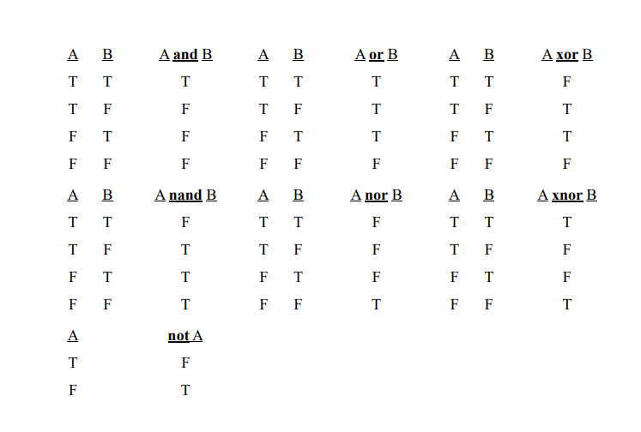
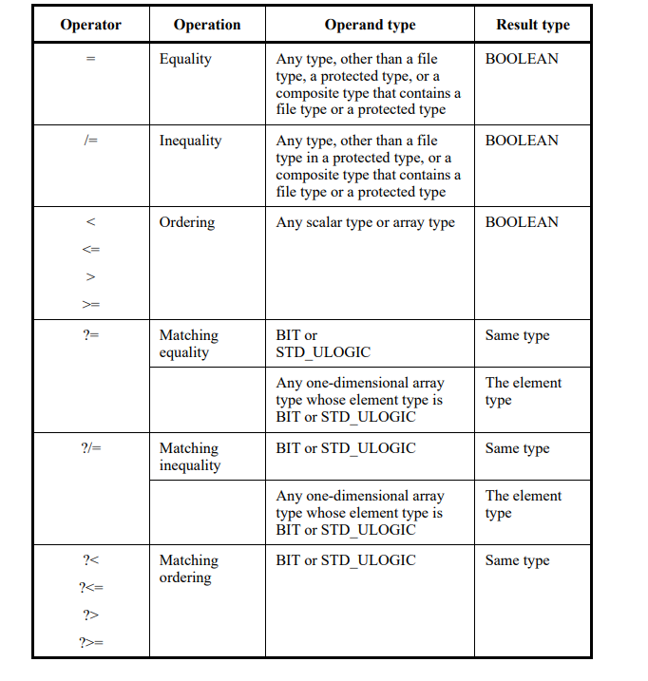
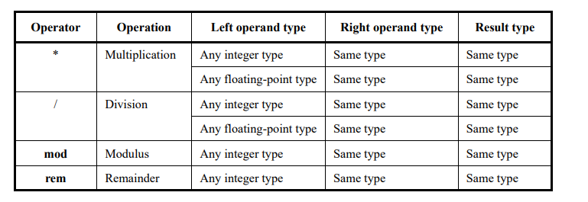
9.2 Operators
A formula that defines the computation of a value.

Slide 33
9.3 Operands
The operands in an expression includes literals, aggregates, function, calls, type conversions.
9.4 Static Expressions
• Utilized in constant declarations or restrictions; fully computed at compile time. • There are two categories of static expression: – If every operator in expression is an implicit defined operator, these are called locally static expressions – If every in the expression is a pure function and every primary in the expression is a global static primary, they are called globally static expressions
9.5 Universal Expressions
•A universal expression is either an expression that delivers a result of type universal integer or one that delivers a result of type universal real
• The same operations are predefined for the type universal integer as for any integer type
• The same operations are predefined for the type universal real as for any floating point type
• In addition, these operations include the multiplication and division operators

Slide 34
11. Concurrent statements
Chapter 11
Presenter:
Mert Ecevit
11.1 General
11.2 Block Statement
11.3 Process Statement
11.4 Concurrent Procedure Call Statements
11.5 Concurrent Assertion Statments
11.6 Concurrent Signal Assignment Statements
11.7 Component Instantiation Statements
11.8 Generate Statements

Slide 35
12. Scope and vısıbılıty
Chapter 12
Presenter:
Orhan Çalışkan
12.1 Declerative Region
12.2 Scope of Decleration
12.3 Visibility
12.4 Use Clauses
12.5 The Context of Overload Resolution

Slide 36
12.1 DECLERATIVE REGION
Declarative region in VHDL is a text area where declarations and definitions are valid
Entity and its associated architecture body
Subprograms (procedures/functions) and their bodies
Packages and their bodies (if any)
Process, block, loop, and generate statement
Declarations belong to the innermost region where they are defined
Structures like the architecture body are not affected by the scope outside their own region
Root Declarative Region: The top-level region of each design
Library Declarative Region: Defined for each design library, encompassing all units within the library
library ieee;
use ieee.std_logic_1164.all;
entity myentity is
-- entity declarative region
...
end myentity;
architecture behavioral of myentity is
-- architecture declarative region
begin
process(...)
-- process declarative region
begin
end process;
end behavioral;

Slide 37
12.2 SCOPE OF DECLERATIONS
The portion of code where a declaration or named entity is valid
Scope defines the usage area of the declaration or entity
Scope starts from the declaration and extends to the end of the innermost declarative region
The scope of an architecture body is limited to its internal region
Structures like package, record type, subprogram parameters, generics and ports extend their scope to the enclosing unit
Architecture body is included in the scope of its associated Entity
Block configurations and Library declarations can extend the scope
PSL verification units can be linked to extend the scope into verification structures.

Slide 38
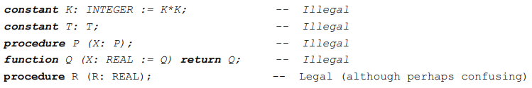
12.3 VISIBILITY
Visibility determines the area where elements of a declaration are valid. A declaration can only be used within its visible scope
Multiple declarations with the same name can be made, and the visibility rules determine which declaration is valid
Component configuration and block configuration declarations can become visible by selection
Use clauses modify the visibility of declarations. Hiding conceals the same-named declarations from the outer scope
An identifier cannot be used at the beginning of a declaration; it is valid only after the declaration end

Slide 39
12.4 USE CLAUSES
Use Clause makes declarations in a package or library directly visible
Using all makes all declarations visible
Declarations can be hidden by homographs
In case of explicit and implicit homographs, only the explicit one is visible
Declarations in uninstantiated packages cannot be made visible
use IEEE.std_logic_1164.all
use work.my_package.all
use work.my_package.my_function

Slide 40
12.5 THE CONTEXT OF OVERLOAD RESOLUTION
Overloading is when the same name or operator refers to different entities in different contexts
Overload Resolution is the process used to select the correct meaning when multiple meanings are possible
RULES
Compatibility between names, expressions, and types
Conformance between parameters and types
Selecting the correct entity based on the context

Slide 41
13. DESIGN UNITS AND THEIR ANALYSIS
Chapter 13
Presenter:
Orhan Çalışkan
13.1 Design Units
13.2 Design Libraries
13.3 Context Declerations
13.4 Context Clauses
13.5 Order of Analysis

Slide 42
13.1 DESIGN UNITS
Independently analyzed constructs that are added to the design library
Design file consists of multiple design units
Primary Units: Core structures like entity declarations, package declarations, and context declarations
Secondary Units: Bodies of primary units, such as architecture bodies
13.2 DESIGN LIBRARIES
Design Library: An implementation-dependent storage area for design units. An application can support multiple design libraries
Library Clause: Defines logical names for libraries in design units. If the same name is defined multiple times, only the first definition is valid.
Working Library: The library where the library unit resulting from the analysis of a design unit is place
Resource Library: Libraries that contain library units referenced in the analyzed design unit

Slide 43
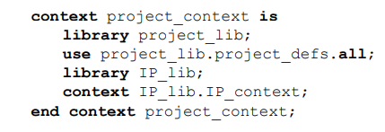
13.3,4 CONTEXT DECLERATIONS / CONTEXT CLAUSE
Context Declaration: Defines context items that design units can reference
Context Clause: Defines the initial name environment before the analysis of a design unit
Scope: library_clause, use_clause, context_reference
Library Clause: Defines the logical library names to be used in the design unit
Use Clause: Makes certain declarations directly visible within the design unit
Context Reference: References another context declaration

Slide 44
13.5 ORDER OF ANALYSIS
The order of design unit analysis is based on visibility rules
A primary unit must be analyzed before the design unit where its name is referenced
A primary unit must be analyzed before its corresponding secondary unit, as the secondary unit depends on the primary unit
In case of an error, the analysis is rejected and does not affect the working library
A changed library unit may affect other units that reference its name
A changed library unit becomes obsolete and must be reanalyzed before it can be used again

Slide 45
14. ELABORATION AND EXECUTION
Chapter 14
Presenter:
Seyit Koçak
14.1 General
14.2 Elaboration of a Design Hierarchy
14.3 Elaboration of a Block, Package, Subprogram or Protected Type Header
14.4 Elaboration of a Declarative Part
14.5 Elaboration of a Statement Part
14.6 Dynamic Elaboration
14.7 Execution of a Model

Slide 46
14.1 GENERAL
To execute a model, the design hierarchy is first elaborated, followed by the initialization of nets, and then the repetitive simulation cycle begins, during which processes are executed and nets are updated
14.2 ELABORATION OF A DESIGN HIERARCHY
Definition: Creates processes interconnected by nets, enabling simulation
Process:
Executes vhpiCbStartOfElaboration and vhpiCbEndOfElaboration callbacks.Prepares block statements and implicit configurations for unbound components
Key Steps:
Elaborates packages sequentially to resolve dependencies
Configures PSL verification units after block elaboration
Creates drivers and initializes scalar signals

Slide 47
14.3 ELABORATION OF a BLOCK, PACKAGE, SUBPROGRAMS OR PROTECTED TYPE HEADER
Describes the preparation of protected types, generics, subprograms, and ports, including their mapping and association. This ensures all components are properly initialized and ready for simulation
14.4 ELABORATION OF A DECLARATIVE PART
Type definitions, subtypes, subprograms, and protected types are elaborated sequentially
. Attribute, configuration, and disconnection specifications are processed
Binding information, default values, and signal associations are properly established
14.5 ELABORATION OF A STATEMENT PART
Purpose:
Ensure concurrent statements are correctly prepared for simulation
Concurrent Statements:
All concurrent statements in a block are elaborated sequentially
Generate Statements:
For-Generate: Creates blocks for each value in a specified range
If-Generate: Creates a block if the condition evaluates to true; otherwise, no block is created
Case-Generate: Creates a block for the matching alternative based on an evaluated expression
Component Instantiation: If bound to a design entity, the corresponding block is elaborated

Slide 48
14.6 DYNAMIC ELABORATION
Definition:
Dynamic elaboration occurs during simulation execution for constructs with sequential statements
Key Instances:
Loop Statements: Loop parameters are elaborated, and the range is evaluated before execution
Subprogram Calls: Parameters are elaborated and checked; exclusive access is required for protected or file operations
Allocators: Subtype elaboration occurs before object allocation
Sequential Blocks: Declarative parts are elaborated before block execution
14.7 EXECUTION OF A MODEL
Drivers: Handle signal value changes via transactions
Signal Updates: Compute and apply driving and effective values
Implicit Signals: Update signals like S'STABLE and S'QUIET per kernel rules

Slide 49
17. VHDL Procedural Interface overview
Chapters 17, 18 and 19
Presenter:
Furkan Kaya
18. VHPI access functions
19. VHPI information model

Slide 50
VHPI Overview
Definition: VHPI (VHDL Procedural Interface) allows interaction between external tools and the VHDL simulation environment.
Purpose:
Extend simulation functionality.
Provide dynamic access to design objects.
Key Components:
Handles: Represent simulation objects (e.g., signals, entities).
Access Functions: Perform operations on these objects.
Callbacks: Trigger actions on specific simulation events.
Example:
vhpi_register_cb(vhpiCbValueChange, signal_handle, my_callback);

Slide 51
VHPI Phases
Phases of Execution:
Registration: Initialize callbacks and external tools.
Simulation: Execute the design while interacting dynamically.
Termination: Clean up and finalize external tool interactions.
Example:
procedure signal_monitor is
variable value: vhpiValueT;
begin
vhpi_get_value(signal_handle, value);
report "Signal value: " & value;
end;

Slide 52
Callbacks
Purpose: Dynamically respond to events during simulation.
Types of Callbacks:
Event-based: Triggered by signal changes or processes.
Time-based: Activated after a specific time.
Phase-based: Executed at specific simulation phases.
Example:
vhpi_register_cb(vhpiCbTime, 50 ns, my_callback);

Slide 53
VHPI Data Types
Definition: VHPI uses predefined data types to represent simulation data and interact with VHDL objects.
Key Data Types:
vhpiInt: Integer type for indices and counters.
vhpiReal: Real type for analog values or delays.
vhpiString: Text-based data.
vhpiValueT: Encapsulates values of signals and variables.
Example:
signal_value: vhpiValueT;
vhpi_get_value(signal_handle, signal_value);

Slide 54
Data Access
Purpose: Access and manipulate data during simulation.
Methods:
Reading values using vhpi_get_value.
Writing values using vhpi_put_value.
Navigating objects using handles.
Example:
signal_value.format := vhpiBinStr;
signal_value.value := "1101";
vhpi_put_value(signal_handle, signal_value, vhpiForce);

Slide 55
VHPI Object Model
Definition: Represents the hierarchical structure of VHDL designs, enabling navigation and manipulation of components.
Key Objects:
Signals: Data carriers between components.
Variables: Local storage within processes.
Processes: Describe behavior.
Components: Instances of entities.
Example:
signal_handle := vhpi_handle(vhpiSignal, architecture_handle);

Slide 56
Object Hierarchy
Structure:
Designs are organized hierarchically, starting from root objects.
Parent-child relationships allow traversal between components.
Usage:
Retrieve handles for signals, processes, or variables.
Navigate design hierarchy dynamically.
Example:
root_handle := vhpi_handle(vhpiRoot, null);
entity_handle := vhpi_handle_by_name("MyEntity", root_handle);

Slide 57
Signal Interaction
Purpose: Manage signal behavior during simulation.
Actions:
Monitor signal value changes.
Modify signal values dynamically to simulate specific scenarios.
Example:
signal_value.value := "0000";
vhpi_put_value(signal_handle, signal_value, vhpiInertial);

Slide 58
Process and Component Interaction
Purpose: Interact with processes and components during runtime.
Actions:
Activate or deactivate processes.
Modify or monitor component behavior.
Example:
process_handle := vhpi_handle(vhpiProcess, entity_handle);
vhpi_set_disable(process_handle, true);

Slide 59
Advanced Use Cases
Applications:
Debugging and monitoring signals.
Automating tests with dynamic modifications.
Interfacing with external tools for co-simulation.
Example:
vhpi_register_cb(vhpiCbAfter, 100 ns, my_callback);
vhpi_get_value(signal_handle, signal_value);

Slide 60
24. STANDARD TOOL DIRECTIVES
Chapter 24
Presenter:
Seyit Koçak
24.1 Protect Tool Directives
24.2 Conditional Analysis Tool Directives

Slide 61
24.1 PROTECT TOOL DIRECTIVES
Encrypt VHDL designs to prevent text disclosure while allowing authorized tools to process the design
Key Elements:
Encryption Envelope: Encrypted text and instructions
Decryption Envelope: Details for decryption
24.1 CONDITIONAL ANALYSIS TOOL DIRECTIVES
Purpose: Allows conditional inclusion/exclusion of VHDL description parts based on tool or user settings
Key Elements:
warning: Adds a warning message, does not stop analysis
error: Stops analysis with an error message
Tool-Supplied Identifiers:
VHDL_VERSION: VHDL version (e.g., "2008")
TOOL_TYPE: Tool type (e.g., "SIMULATION")
TOOL_NAME/EDITION/VERSION: Tool-specific details

Slide 62
End of IEEE 1076 – 2002 Standard
VHDL Project Closure Presentation
THANKS
Furkan Kaya,
Mert Ecevit,
Orhan Çalışkan,
Seyit Koçak
Yunus Küçük
www.youtube.com/@falsepaths

